Slide 1
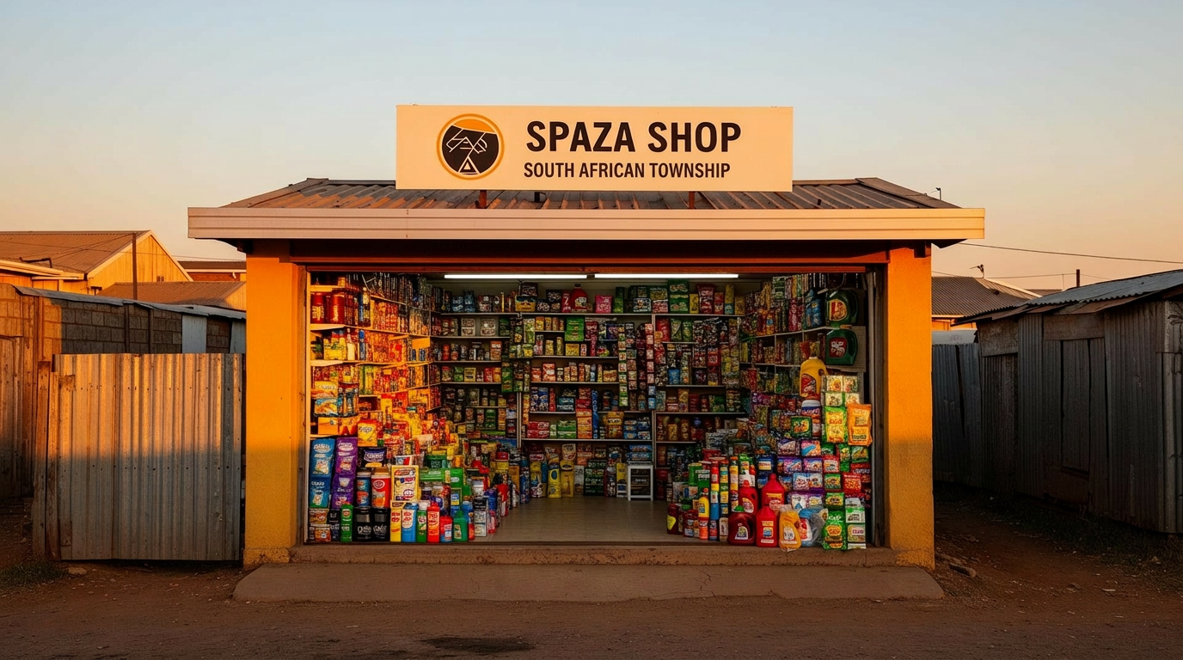
SPAZA SUPPLY
Affordable Stock Access for South Africe

Slide 2
Group Members
Nkabane L - 261330520
Ndlovu PT - 251041377
Baloyi H - 240704323
Komape KL - 260868829
Mzimba N - 260225596
Zungu MS – 242098501
Maphoso MA – 250835922

Slide 3

Introduction and Background
Executive summary
Spaza shop owners face severe structural supply chain constraints that reduce overall local competitiveness. This review evaluates specific logistical hurdles and proposes interventions to drive sustainable regional growth.

Slide 4
LOCAL ECONOMIC RESILIENCE
Informal retail channels serve as the economic lifeblood of South African townships.
Removing logistical bottlenecks from the informal retail chain directly stabilizes household food security in marginalized neighborhoods.
By optimizing operations, money is kept circulating within township communities, driving local economic development and employment.

Slide 5
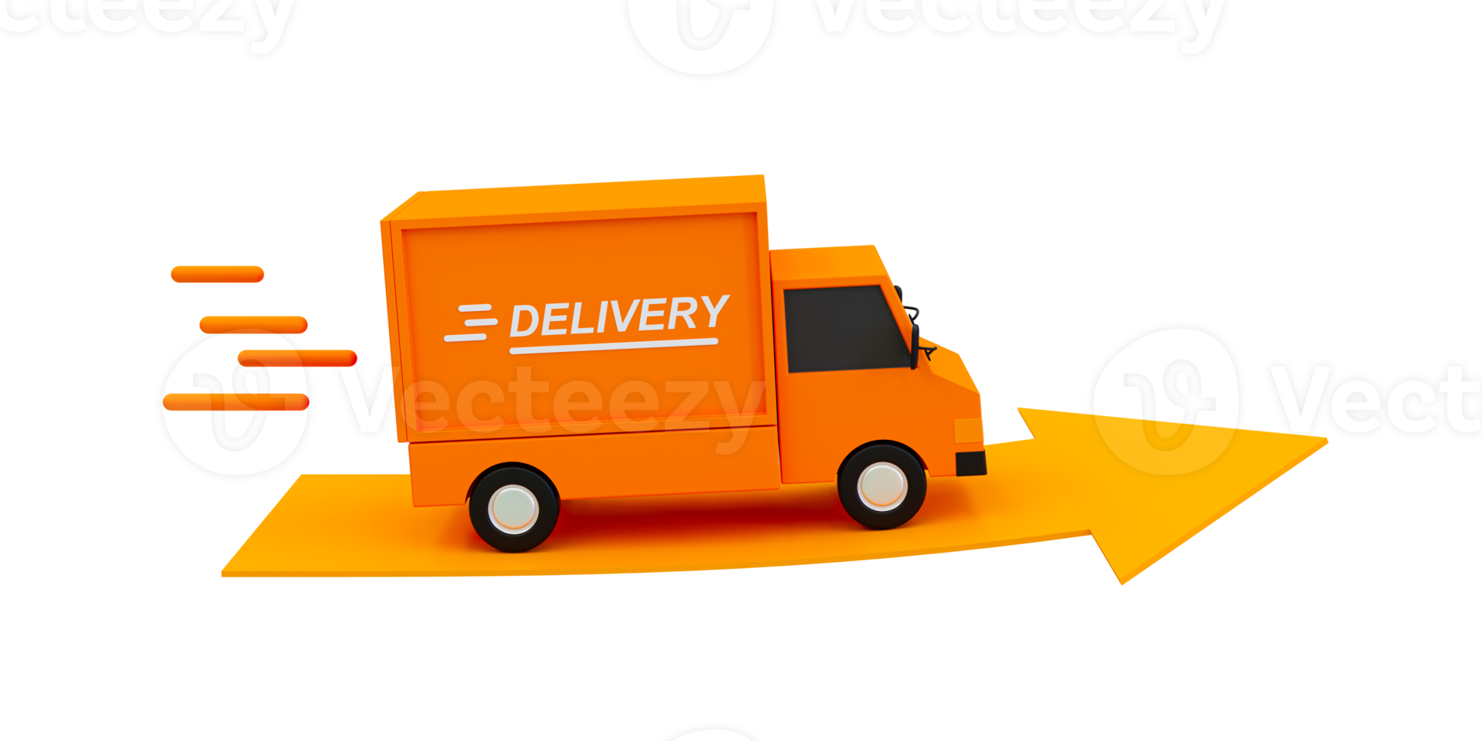
Current Supply Chain Barriers
Transport And Access Limit
High transportation expenses directly inflate procurement costs, resulting in narrow operating margins.
Sourcing products from distant central wholesalers consumes valuable daylight trading hours, taking owners away from shops.
Irregular or costly travel options lead to frequent and damaging stockouts of high-demand household necessities.

Slide 6
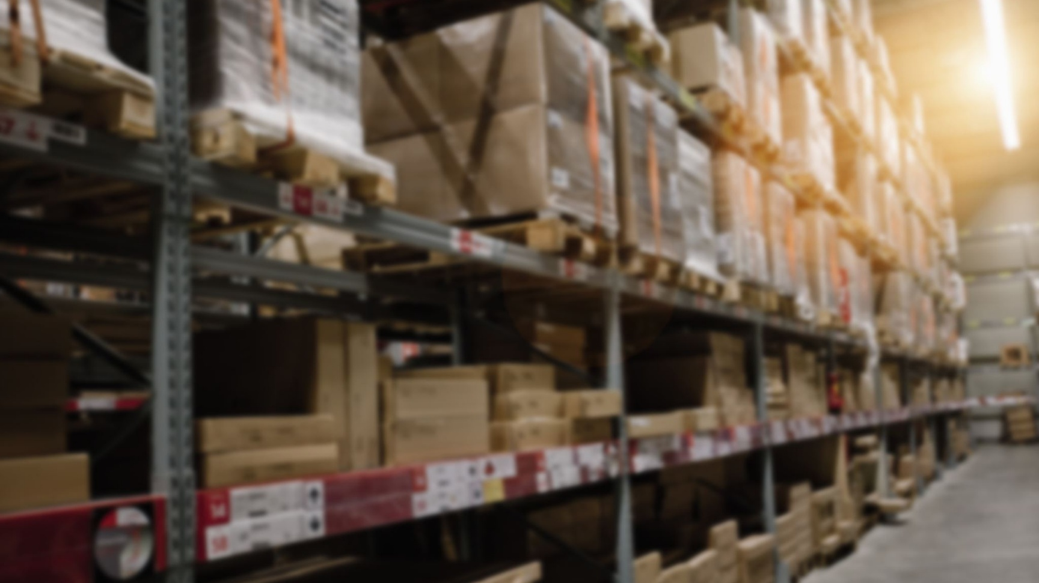

2. Middleman & Intermediary Markups
Because single spaza shops operate with limited, isolated volume, they are frequently excluded from direct manufacturer pricing schedules.
This structural isolation forces reliance on traditional wholesale middlemen.
Each intermediary level adds an extra margin layer, driving retail shelf prices up significantly by the time goods reach local community shoppers.

Slide 7
Solution Specification & Interventions
Digital Ordering
1
We give shop owners a simple website to place orders.
Cooperative Buying
2
We help local shops team up by buying together .
Shared Logistics
3
Instead of sending separate trucks we use shared deliveries, one truck delivers to many shops in the same area

Slide 8
MODERN DIGITAL INTEGRATION MODEL
Mobile platforms built for low data usage allow owners to request stock seamlessly via instant text or audio.
Direct digital receipts and price transparency eliminate arbitrary cash markups on basic goods.
Standardizing transaction records simplifies stock planning and helps retailers qualify for working capital support.

Slide 9
Building Robust, Formal Micro-Retail Systems
By blending localized transport networks with community buying groups, spaza stores can transition from isolated entities into a highly synchronized, formal micro-retail network capable of competing directly with major corporate supermarket chains.
DIRECTING US TO THE SOLUTION
Contact:coop@townshipretail.co.za
Location: Johannesburg, South Africa

